Slide 1

CyberSecurity Data breach Data Analysis
Justin Brose – ISDS 3200

Slide 2
About me
Why did I choose this topic? I am currently employed as an Information Security Analyst, and I found this topic to be closely-related to my position's responsibilities.
How does this project help me professionally? I believe that this project will give me a greater insight to what end-users are vulnerable to in a historic sense. Thus, I will be able to apply this knowledge to various functions preformed within my job role daily.

Slide 3
Data Source
This data was pulled from the data science centric website, Kaggle.
Link: (https://nam04.safelinks.protection.outlook.com/?url=https%3A%2F%2Fwww.kaggle.com%2Fdatasets%2Falukosayoenoch%2Fcyber-security-breaches-data&data=04%7C01%7Cjbrose1%40lsu.edu%7C3e9a430291fc44224e0c08da0db1a8b2%7C2d4dad3f50ae47d983a09ae2b1f466f8%7C0%7C0%7C637837353925561629%7CUnknown%7CTWFpbGZsb3d8eyJWIjoiMC4wLjAwMDAiLCJQIjoiV2luMzIiLCJBTiI6Ik1haWwiLCJXVCI6Mn0%3D%7C3000&sdata=ywd85QnLshv81jtrkp6CAKZDaGtHx5KBEEzC1VNja0c%3D&reserved=0)

Slide 4
Data Set Contents
This data set contains 13 columns of data attributes. Additionally, the data provided shows various information points of data breaches carried out in a short period of time.
The columns in this data set are the following:
Number (functions as an index)
Name_of_Covered_Entity
State
Business_Associate_Involved
Individuals_Affected
Date_of_Breach
Type_of_Breach
Location_of_Breached_Information
Date_Posted_or_Updated
Summary (I plan to omit this in final presentation)
Breach_Start
Breach_End
Year

Slide 5
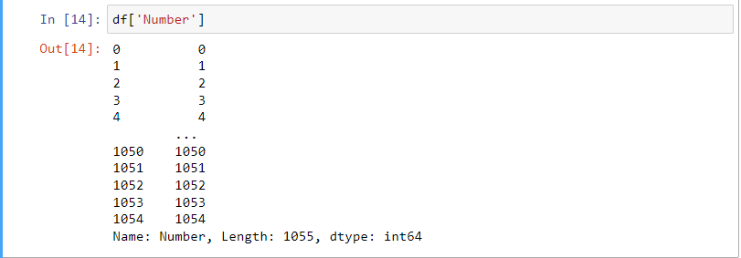
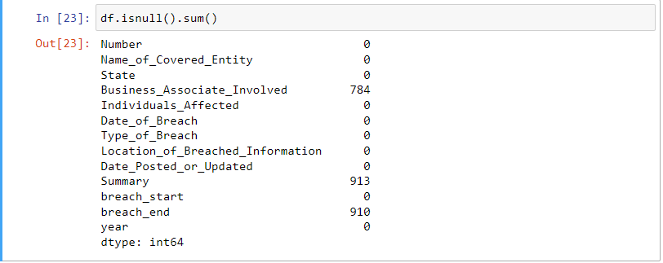
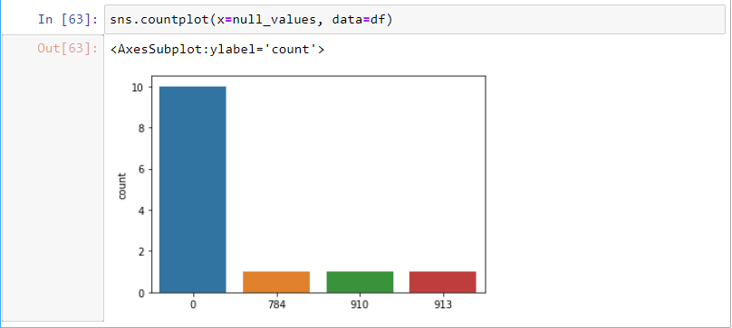
Amount of Data and Missing Data
After running appropriate code on the data frame I have determined that there are 1054 records in this data set and the columns that are missing the most data are “Business_Associate_Involved”, “Summary”, and “breach_end”.
At this point in time I plan to remove the “Summary” Column. I believe this is wise because not only does the summary column provide minimal value to me while performing data analysis, but also it contains the most NULL values in the data frame.
As for “Business_Associate_Involved” and “breach_end”, I have not conducted enough analysis to determine if these columns are valuable, so for now they are to remain in the data frame.

Slide 6

Types of Analytical Questions
Easy (4 questions)
Medium (3 questions)
Complex (2-3 questions)

Slide 7
Analysis to Be preformed
Easy Questions
Medium Questions
Complex Questions
What is the first year stated in the dataset?
What is the last year stated in the dataset?
How many individuals in total were affected by data breaches?
How many years does this dataset cover?
How many unique states were affected by a data breach(s)?
How many of each type of breach exist in the dataset?
What is the most common location of breached information?
What state has the most affected individuals organized by year?
Does the breach type and location correlate to the number of individuals affected?
Does the date of the breach correlate to the type of data breach performed? Was there a popular data breach type in a certain year?

Slide 8

Thank You!
Please address all questions to:
Jbrose1@lsu.edu

